Slide 1

Meet the Teacher
Year 6
Mrs. Gilbey

Slide 2
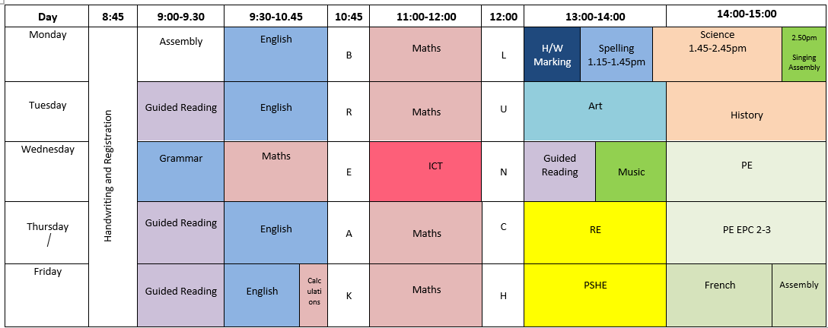
Timetable

Slide 3
What is new this year for your child in Year 6
Children are expected to take complete responsibility for their own home learning
Children take on more responsibilities around the school and set an example to younger children with their behaviour and conduct.
Residential trip to PGL to support team building
Bikeability course in the Spring term.
Key Stage 2 SATs tests in May 2027.
Begin preparing for transition to secondary school in the summer term.
Year 6 production!

Slide 4
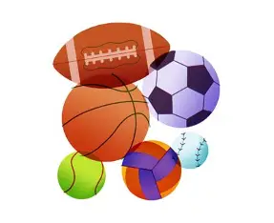
Pe Days
Wednesdays and Thursdays
Each child should come to school in full PE kit.
If it is muddy, they are welcome to bring a change of footwear for after PE.
Long hair must be tied back (as it is for the school day).
Earrings and watches, including Fitbits, must be removed for PE on health and safety grounds and placed in the class valuables box.

Slide 5

Reading
Regular (daily) reading is essential
This could include reading books, newspapers, or magazines/comics, in fact the wider range of genre that your child reads, the better.
Try to talk to your child about their reading from regularly and continue to listen to them read – this helps to gauge their comprehension of the text they are reading. And also helps to build enjoyment in reading!

Slide 6
Home Learning
Maths - Mondays
Handed out on Monday and due in the following Monday. Marked together in class on the day.
Spelling
Handed out on Thursdays and test typically on Tuesdays.
Year 3/4 and 5/6 Statutory lists – regular practice

Slide 7
Spellings
3 in a Row Try to get three spellings correct in a row. Add some that follow the same rule. If you make a mistake you have to go back and start again! | Dictionary Definitions Look up the definition of your spelling words and write up their meanings. | Dictation Ask someone to read out your words in a sentence. Write them down ensuring that the spelling and punctuation are as accurate as possible. Include a word that follows the rule but is not on your list.
Spelling Pictures Turn your spellings into a picture to help you remember them. | Big Letters Write out your spelling enlarging the letters that follow your rule. Rec ei ve | 10-word Challenge Can you explain your spelling rule in ten words or fewer? Drop the ‘e’ when adding ‘ing.’
Shannon’s Game/ Hangman Play this with an adult to practise your spellings. Ask the adult to include words that follow the rule but are not on your list! a _ _ l _ | Poster Rule Make a poster explaining your spelling rule. | 3D Spelling Make your spelling words out of Playdoh, Lego, pipe cleaners etc. Include two extra words that follow the same rule but are not on our list.
Stair Steps Create stair steps for each of your spellings. S Sp Spe Spel Spell Spell | Word Hunt How many times can you find words that follow your rule in print e.g. newspapers, books, on public signs etc? | Spelling Sentences and Test Write your words into spelling sentences. Learn them and then ask someone to test you on the spellings and the rule.

Slide 8

Parental Consent Forms
Independent walking home (if any changes from Year 5)
Mobile Phone agreement

Slide 9

PGL
5th-9th October 2026
Focus on being independent, team building and having fun!
Please inform me asap if there is something in particular you’d like to discuss about your child to make them more comfortable and confident (i.e. sleeping or eating habits)
Keep children’s old trainers as spares for the trip!
Marchants Hill

Slide 10
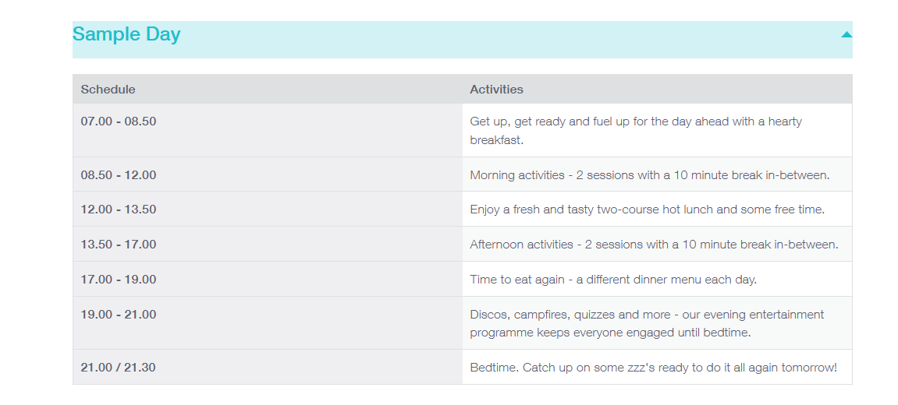
Sample Day

Slide 11
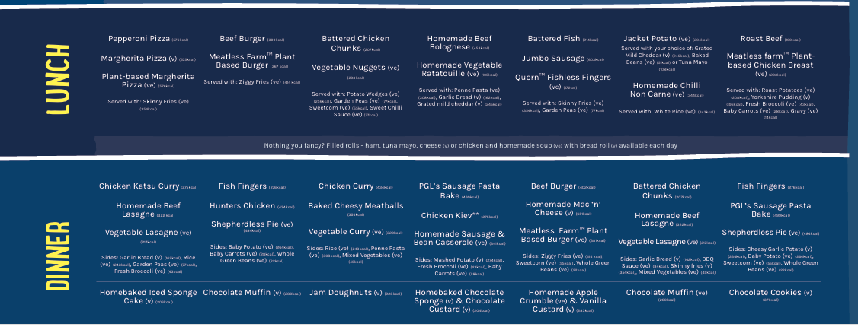
Sample Menu

