Slide 1


Welcome to Year 3
With Miss Costello, Mrs Trentini, Mrs Middlemist and Mrs Smith

Slide 2
Curriculum
English
During the first half of the Autumn Term, the children will be focusing on two books: The Wilderness and Leon and the Place Between. Throughout both units of work, the children will explore a range of engaging writing opportunities inspired by these texts. They will write an array of text types.
Maths
During the first half of the Autumn Term, the children will be learning place value with Miss Costello and shape with Mrs Loyal. The place value includes partitioning, ordering, comparing and rounding numbers. The shape topic includes area, perimeter, and angles.
Science
Year 3 begins with the topic of light.
Throughout Year 3, they will also explore rocks, forces and magnets, plants and animals including humans.
Reading
Throughout Year 3, a variety of genres will be read during Guided Reading, reading for pleasure time and book club.
Some Year 3 books for the Autumn term include:
The tin forest
Matilda
Arthur and the Golden Rope
Leon and the Place Between

Slide 3
Curriculum
PSHE: Being me, Celebrating difference, dreams and goals, healthy me, relationships and Changing me
Music: Recorders, three little birds, and the dragon song.
Geography
Climate zones
North America
Local area
French
Learning French Basics
Animals
Musical instruments
Fruits
Verbs
Art
Drawing/Sketching
Painting and Mixed Media
Fabric of nature
Computing
Touch typing
Powerpoints
Microbits
Spreadsheets
Coding
Branching databases
History
The stone age to iron age
Romans
History of the local area
RE
Jewish celebrations
Rites of passage
The bible
PE
EPC – Football, Tag Rugby, Netball, Hockey, tennis and Cricket
Class Teacher – Dance, gymnastics, athletics and swimming
DT
Cushions
Mechanical toys
Electrical systems
Wearable technology
Constructing a church

Slide 4
New opportunities in Year 3
This year, the children will be introduced to several exciting new subjects and skills as part of the Key Stage 2 curriculum. These include:
French
Learning to play the recorder
Swimming lessons, which will take place during the Summer term
These opportunities help to broaden the children’s learning experiences and develop new areas of confidence and creativity.

Slide 5
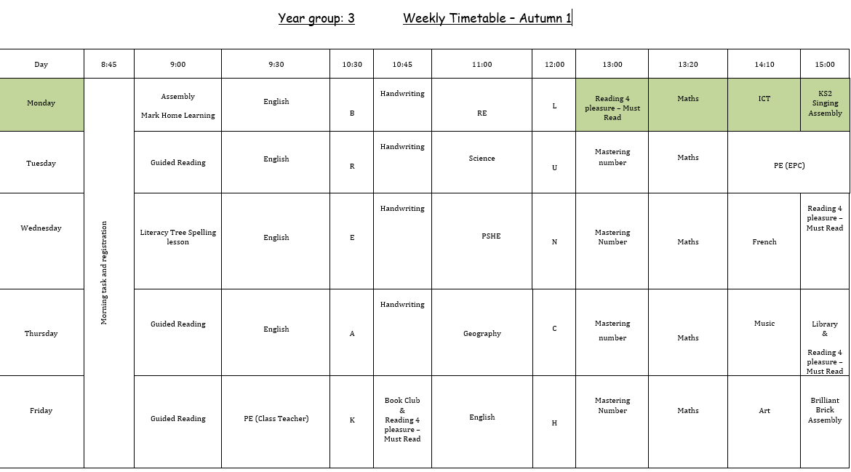
Weekly Timetable
PE days – Tuesday and Friday
Library – Thursday
Book Club – Friday

Slide 6
Home learning
Maths and Spelling
Maths home learning will be set on Monday and need to be returned by the following Monday.
Spelling words to practice will be set on Thursday and the spelling test will be the following Tuesday.
Spellings and Maths sheets will be on the Teams classwork page.
Reading at home (3x a week)
It is imperative that children are reading at home and being read to at home.
Reading record must be signed 3x a week by an adult.
The children are welcome to read books outside of their school books however to progress in the reading levels they must have read a wide variety of the school books in their level.
Some parents last year found it useful to alternate the reading of a story. E.g., the children read one page, adult reads the next. They also found listening to their child in the car to be an easier space to encourage reluctant readers.
Times-table practice
Times-table Rockstars
Worksheets
Talking Times-tables
Quick fire questioning
By the end of Year 3, children are expected to confidently recall the 2, 3, 4, 5, 8, and 10 times tables
Things from home
We kindly ask that children do not bring toys, teddies, or other personal items from home unless specifically requested to.
Show and tells
While we do not have regular Show and Tell sessions, we are always happy to celebrate achievements during whole-school assemblies or share items that are relevant to our current learning topics. We will incorporate these opportunities when time allows, but please be aware that it may not always be immediate due to the demands of the school day.

Slide 7
Behaviour
This year, the children have moved to KS2 and we focus on encouraging a developing independence and a sense of self-responsibility. The children are expected to be building a positive attitude to learning and ensure they take pride in their work. The school behaviour policy is on the website and details our school response to all behaviour. We also follow a ‘Ready to Learn’ approach in all classes.
The children will be encouraged to communicate any worries with their classroom adults throughout the day so that all situations can be resolved in the moment however please do not hesitate to speak to me on the playground or email admin@hatchride.Wokingham.sch.uk if you ever have any concerns or queries.

Slide 8
Any Questions?

