Slide 1


Meet the Teacher
Mr Jones – Year 2

Slide 2
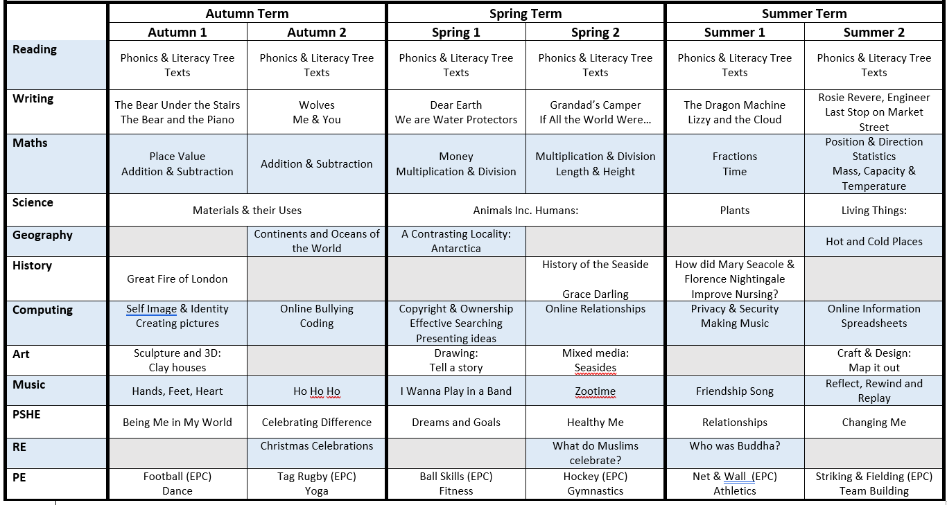
Curriculum Overview

Slide 3
Routines
Develop learning behaviours from Y1 e.g. independence, perseverance, resilience, relationships
High expectations
Behaviour and rewards
Entering the classroom with independence
Home time from Y2 Classroom door
Parent-teacher communication
Reading – Whole class guided reading 4 times a week.
Once we have an additional LSA, we aim to hear individual reading once a week. Depending on need, this may be more. Please try to hear your child read at least three times a week. Children are being trained to change their reading books.
PE – Mondays (EPC) and Fridays
Home learning – Weekly spellings and maths. Issued on Mondays, spelling tests on the following Monday.
Wellies and waterproofs in school
Two class assemblies. KS1 Nativity is Tuesday 8th December.

