Slide 1
Welcome to Year 1!
Class teacher - Miss Gorrod
LSAs - Mrs Reading, Mrs Low and Ms Smith

Slide 2
A day in Year 1
We have begun using continuous provision in Year 1 this year, so the day will feel very familiar to the children following on from their time in Reception.
We will begin a session with a whole-class input before the children move into their ‘busy time’ in the provision. During this time, children will have opportunities to explore, practise their learning and develop their independence.
Everyone will also have the opportunity to visit the ‘tutor table’, where they will work in a small group with an adult to complete a focused task linked to their learning.
Throughout the year, we will introduce lots of exciting new curriculum topics. Our curriculum overviews are available on the school website and provide an overview of the topics and learning covered across Year 1.
There will still be time to sit together and enjoy a snack before heading outside for playtime. We will aim to get outside as much as possible – whether we are playing, exploring or learning!

Slide 3
Behaviour
On our first day, the children created a class charter where we discussed what needed to do now we are in Year 1.
They covered a lot of behaviours that are part of our ‘Ready to Learn’ behaviours. We want all children to try their best, be kind and resilient and model how they are ready to learn in all areas!
The ‘Ready to Learn’ is part of our behaviour policy. It is on our school website. Please come and speak with me if anything else needs further explanation.

Slide 4
Reading
We ask that you read with your child at least three times a week. Reading both with and to your child plays a vital role in developing their language, comprehension and overall literacy skills.
It is particularly important to hear your child read aloud as this helps them to develop their fluency skills, including segmenting and blending the sounds they are learning throughout the year.
To support reading at home, our Reading VIPERS question prompts are available on our class Teams page. These can help guide discussions about the books your child is reading and develop their understanding and comprehension of what they have read.
Please remember to sign your child’s reading record each time you read with them at home. In addition to their school reading books, we also encourage children to explore a variety of age-appropriate books and texts at home, both to support their reading development and to encourage a love of reading for pleasure.
Finally, we will be visiting the library every Monday, where children will have the opportunity to choose a book to borrow and enjoy at home.

Slide 5
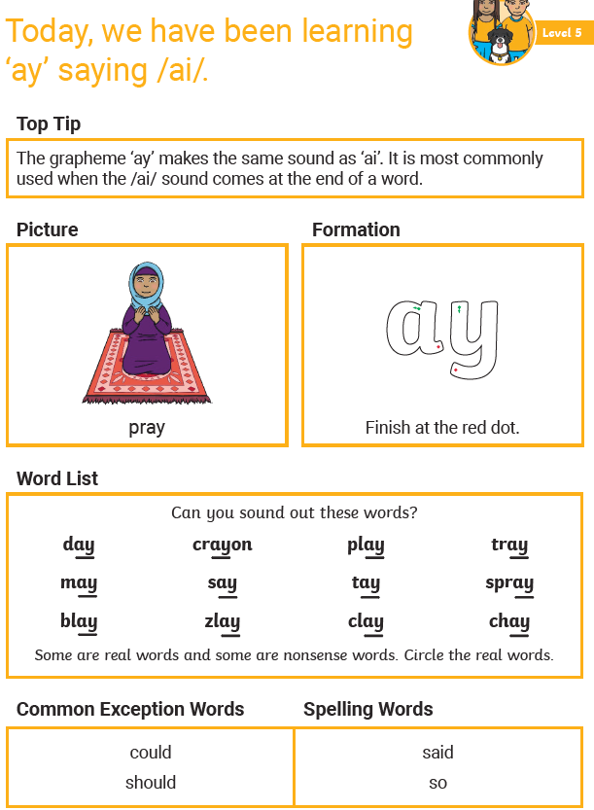
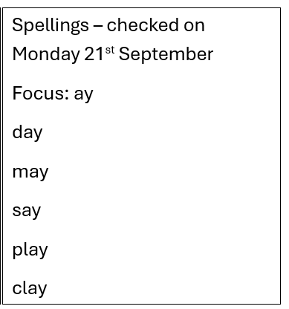
Spellings
A spelling list will be shared every Monday, with words that are directly linked to the Level 5 sound being taught that week. The words will be introduced and practised in school throughout the week.
We ask that you practise the words and the new sound at home to reinforce the skills being taught in school. Regular practice will help your child to develop their confidence with spelling and apply their phonics knowledge when writing. Children will have spelling tests throughout their time at school, so developing good spelling habits from an early age is important.
For the start of the year, the spellings will be checked with an adult in a small group as part of our small group writing task on a Monday morning.
A spelling practice sheet will be provided alongside the weekly spelling list to support you with practising the words and sound at home. The first spellings will come home on Monday 14th September.

Slide 6
Things to remember
Water bottles and coats
Please ensure that all water bottles, coats, and jumpers are clearly labelled with your child’s name. As the weather becomes colder, it is important that children come to school with a coat each day, particularly between November and March, as they will be outside during playtimes and lunchtimes.
Show and tells
While we do not have regular Show and Tell sessions, we are always happy to celebrate achievements during whole-school assemblies or share items that are relevant to our current learning topics. We will incorporate these opportunities when time allows, but please be aware that it may not always be immediate due to the demands of the school day.
Snacks
Information regarding suitable snacks has already been shared with parents and carers. As a reminder, any snacks that do not meet the school's healthy eating guidelines will be set aside and returned to the child at the end of the school day.
Wellies and waterproofs
Please send your child in with a named bag containing waterproof trousers and welly boots. These will be kept in school so your child is ready to get outside whenever we can! A waterproof jacket is welcome, but a normal coat worn to school is absolutely fine too.

Slide 7
PE
Our PE lessons are on Tuesdays and Thursdays.
Children should wear their PE kit to school on these days, including trainers.
Earrings must not be worn and long hair must be tied back.
Tuesday PE sessions are with Lucas at EPC and Thursday PE sessions are taught by Miss Gorrod.

Slide 8
Key days
Class assemblies
Friday 22nd January 2027
Friday 21st May 2027
Monday
Library
In class spelling check (starting on Monday 21st September 2026)
Book change day
Tuesday
EPC PE (wearing PE kit into school)
Thursday
Class teacher PE (wearing PE kit into school)
Book change day
Class trips
21st October 2026– Milestones
23rd April 2027 – Windsor castle
June 2027 – walk along Hatch Ride

Slide 9
Thank you for coming!
Any questions?
If you think of questions at a later time, please email admin@hatchride.wokingham.sch.uk or speak to Miss Gorrod before or after school

