Slide 1
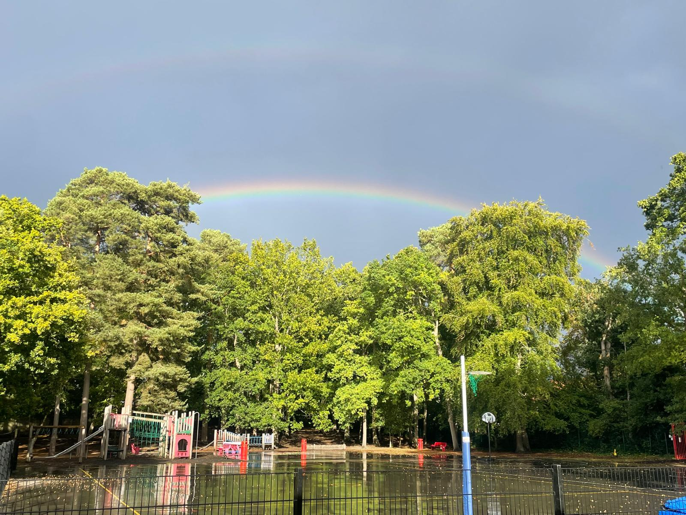


Slide 2
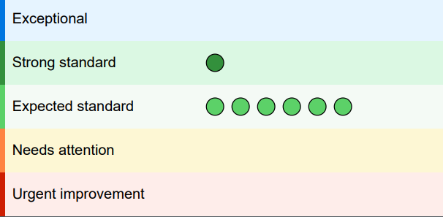
Ofsted 2026
Strong standard
The school reaches a strong standard.
Leaders are working above the standard expected of them.
Expected standard
The school is fulfilling the expected standard of education and/or care.
This means they are following the standard set out in statutory and non‑statutory legislation and the professional standards expected of them.
Strong Standard - EYFS:
“Approaches help children sustain engagement, deepen their understanding and build confidence as learners. Consequently, children achieve well from their starting points and are well prepared for Year 1.”
Ofsted July 2026

Slide 3
“Leaders have designed a curriculum that helps children develop the knowledge and skills they need for future success.”
“Staff create a warm and welcoming
environment where children feel safe, valued and ready to learn.”
“Leaders have established clear routines and high expectations that help pupils understand what it means to be ready to learn. Staff apply these approaches consistently and build positive relationships with pupils, helping them feel safe, respected and supported.”
“Staff build positive relationships with pupils and use a range of approaches to help them participate fully in learning and school life.”
Ofsted July 2026

Slide 4
Attendance – Every Day Counts!
“Leaders make attendance a high priority and have established effective systems to help pupils attend school regularly.”
Attendance at primary school is critically important because it lays the foundation for a child's future learning and development.
📚 Builds Essential Skills: Reading, writing, and math skills are taught consistently over time.
Missing days means gaps in understanding that can be hard to catch up on.
🧠 Establishes Good Habits: Early regular attendance teaches responsibility, punctuality, and routine.
These habits carry into secondary school and adult life.
👥 Supports Social Development: Children build friendships, learn teamwork, and develop communication skills.
Being absent from school can lead to feelings of isolation, difficulty fitting in and affect friendships.
📉 Prevents Falling Behind: Learning is structured in a sequence—missing a step can make the next one harder.
Even a few missed days can affect reading fluency or math progression.
🎓 Long-Term Impact: Studies show that poor attendance in primary school is linked to lower achievement in later years.
Early gaps in learning often widen over time.
💬 Final Thought: “Primary school isn’t just the beginning—it’s the building block for everything that follows.”

Slide 5
Impact of lateness
Impact of absence
Minutes lost each day | Days lost per school year
5 | 3 days
10 | 6 days
15 | 10 days
30 | 19 days
% attendance | Missed lessons per year
95% | 50
90% | 100
85% | 150
80% | 200
Please be aware that children are very honest and will tell us why they are away, it makes it very difficult for them if they are expected to tell an untruth to a member of staff they trust and value

Slide 6
Home-School Communication
Tier 1
This is the first point of contact between families and school.
Office staff | Class teacher
Reporting an absence School events information/changes to usual school day (check newsletter/parent mail/website first) Information regarding clubs Request/return forms requesting a leave of absence Medication/injuries/illness School lunch queries Payments | Home learning queries Behaviour issues/concerns Home/pastoral/friendship concerns Class activities/events/trips Learning/progress concerns Curriculum queries
Tier 2
If after working with the class teacher, further support is required, the following members of the senior leadership team are available. This can be organised through the school office or in collaboration with the teacher.
SENDCo – Mrs Flavin | Assistant Headteacher – Mrs Brigham
Escalated SEND concerns Information about SEND external agency referrals On-going SEND correspondence Emotional/mental health support Safeguarding concerns | Safeguarding concerns Escalated behaviour concerns Escalated pastoral concerns/confidential information
Tier 3
Headteacher
Safeguarding concerns Staff concerns Policy enquiries Issues still requiring resolution after Tier1 and Tier 2 Complaints procedure Attendance

Slide 7
Behaviour for Learning (R2L)
What is "Behaviour for Learning"?
The habits and attitudes that help children learn effectively.
Includes focus, effort, resilience, cooperation and responsibility.
Children understand that teacher feedback is not ‘a telling off’ but a dialogue to facilitate progress and learning.
Children understand that if they have not completed work due to poor behaviour for learning they will be kept in briefly
to talk through what has happened (teacher professionalism)
🧠 Why It Matters:
Good behaviour supports better learning outcomes.
Encourages a calm, focused classroom where all children can thrive.
🏡 How You Can Help:
Talk about school positively and regularly.
Establish routines (sleep, homework, screen time).
Praise effort, not just results.
Model behaviour: Show kindness, patience, and curiosity.
Work with the school: Stay informed and engaged.

Slide 8
Addressing behaviour
Hatch Ride has a behaviour policy, which outlines expectations for behaviour and how positive behaviour is encouraged and managed.
The policy can be found on the school’s website.
Positive behaviour:
Creates a safe, respectful environment
Supports learning and emotional wellbeing
Builds social skills and empathy
Reduces disruptions in class
We aim to teach children how to regulate emotions, make positive choices and take responsibility for their behaviour.
Key Takeaways for Parents
Stay informed: Know the school’s rules and systems
Stay supportive: Support the school with behaviour management and reinforce expectations at home
Stay proactive: Seek help early if needed
Stay positive: All children misbehave at some point; it is a normal part of development, but do remember that there are
two sides to every story!

Slide 9
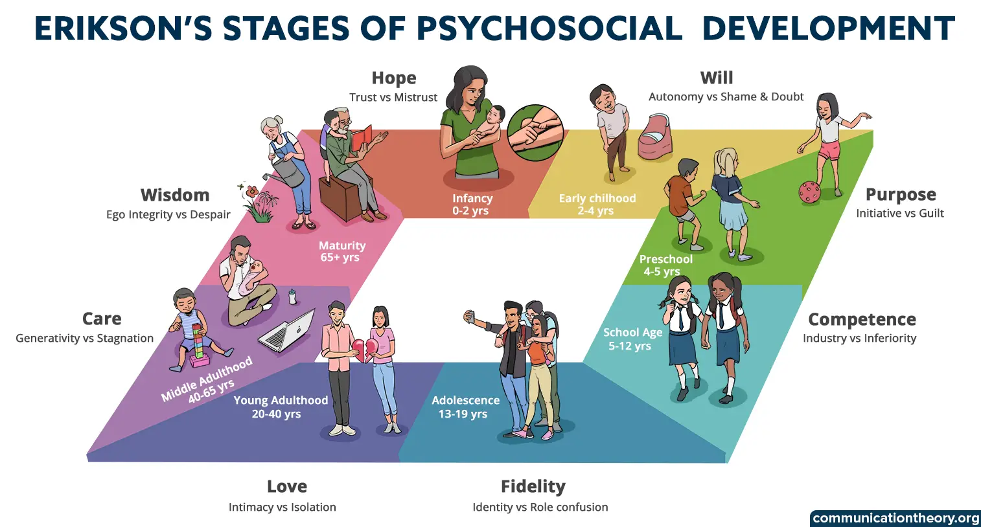
Child Development Stages - Erikson
School-Age (6 - 12 years)
- Expand understanding of the physical & social worlds
Develop identity & values
Develop learning skills
Develop tolerance
Self-esteem and the esteem of others is gained through the successful completion of realistic tasks and the achievement of meaningful goals
Failure is development
Failure helps develop competence
Competence at specific task produces feeling of being useful and able to contribute

Slide 10

Assessment
All children are assessed in school, either through lesson planning, teacher questioning and feedback or through formal assessments.
Our formal assessments are used to measure a child’s learning and progress against national or curriculum standards at specific points in the year.
They also to identify strengths and areas where more support may be needed.
All children take similar formal tests under similar conditions (timing, level of support etc.)
They will be supported where necessary and in-line with normal classroom practice.
It is important that children become familiar with assessments that are appropriate for their age as this is an intrinsic part of school life.

Slide 11

Packed Lunches & Snacks
Key Stage One:
Children in KS1 and Reception receive a free piece of fruit or vegetable everyday at breaktime as part of the Government’s School Fruit and Vegetable Scheme .
Children up to the age of five are eligible for free milk every day.
If any other children would like milk, it can be ordered at a subsidised price. Contact the office for further details.
Key Stage Two:
Breaktime snacks should be a piece of fruit, crackers, rice cake, cheese, cereal bar (no nuts or chocolate).
*Snacks should not include sweets, chocolate, crisps (or other salty snacks), pastries or cakes.
These will be removed and returned at the end of day.
Special diets and allergies
The school recognises that some pupils may require special diets that do not allow for the standards to be met exactly.
In this case, parents and carers are urged to be responsible in ensuring that packed lunches are as healthy as possible. For these reasons pupils are not permitted to swap food items.
This is a nut free site and no nuts or nut products are to be brought onto the school site
NO SEEDED BREAD – air-born allergy present

Slide 12
Inclusive Practice
“Leaders have established a welcoming culture where pupils are known well and valued as individuals.”
Ofsted July 2026
“Staff build positive relationships with pupils and use a range of approaches to help them participate fully in learning and school life.”
Ofsted July 2026
Quality First Teaching
Ordinarily Available
Intervention – long term and short term – daily/one-off
Fidget ‘tools’

Slide 13
Safeguarding
“The safeguarding standards are met. This means that leaders and/or those responsible for
governance and oversight fulfil their specific responsibilities and have established an open
culture in which safeguarding is everyone's responsibility and concerns are actively
identified, acted upon and managed. As a result, pupils are made safer and feel safe.”
Ofsted July 2026
Assemblies
NSPCC
PANTs – Pantasaurs
KCSIE Updates
AI – AI generated images, misinformation and risks of AI
Respect and attitudes online – misogyny
Child-on-child abuse – verbal, online, bullying
Gender Questioning – schools working with parents
External Agencies
Meeting threshold
A collaborative approach to safeguarding

Slide 14
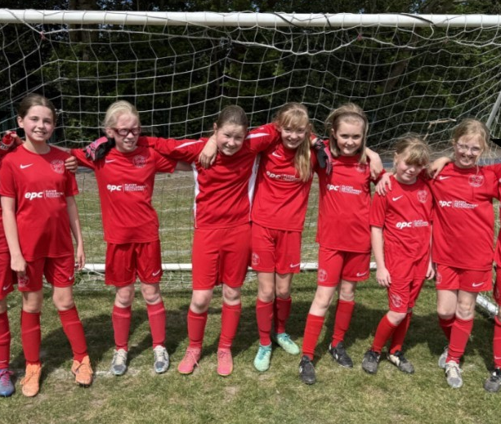
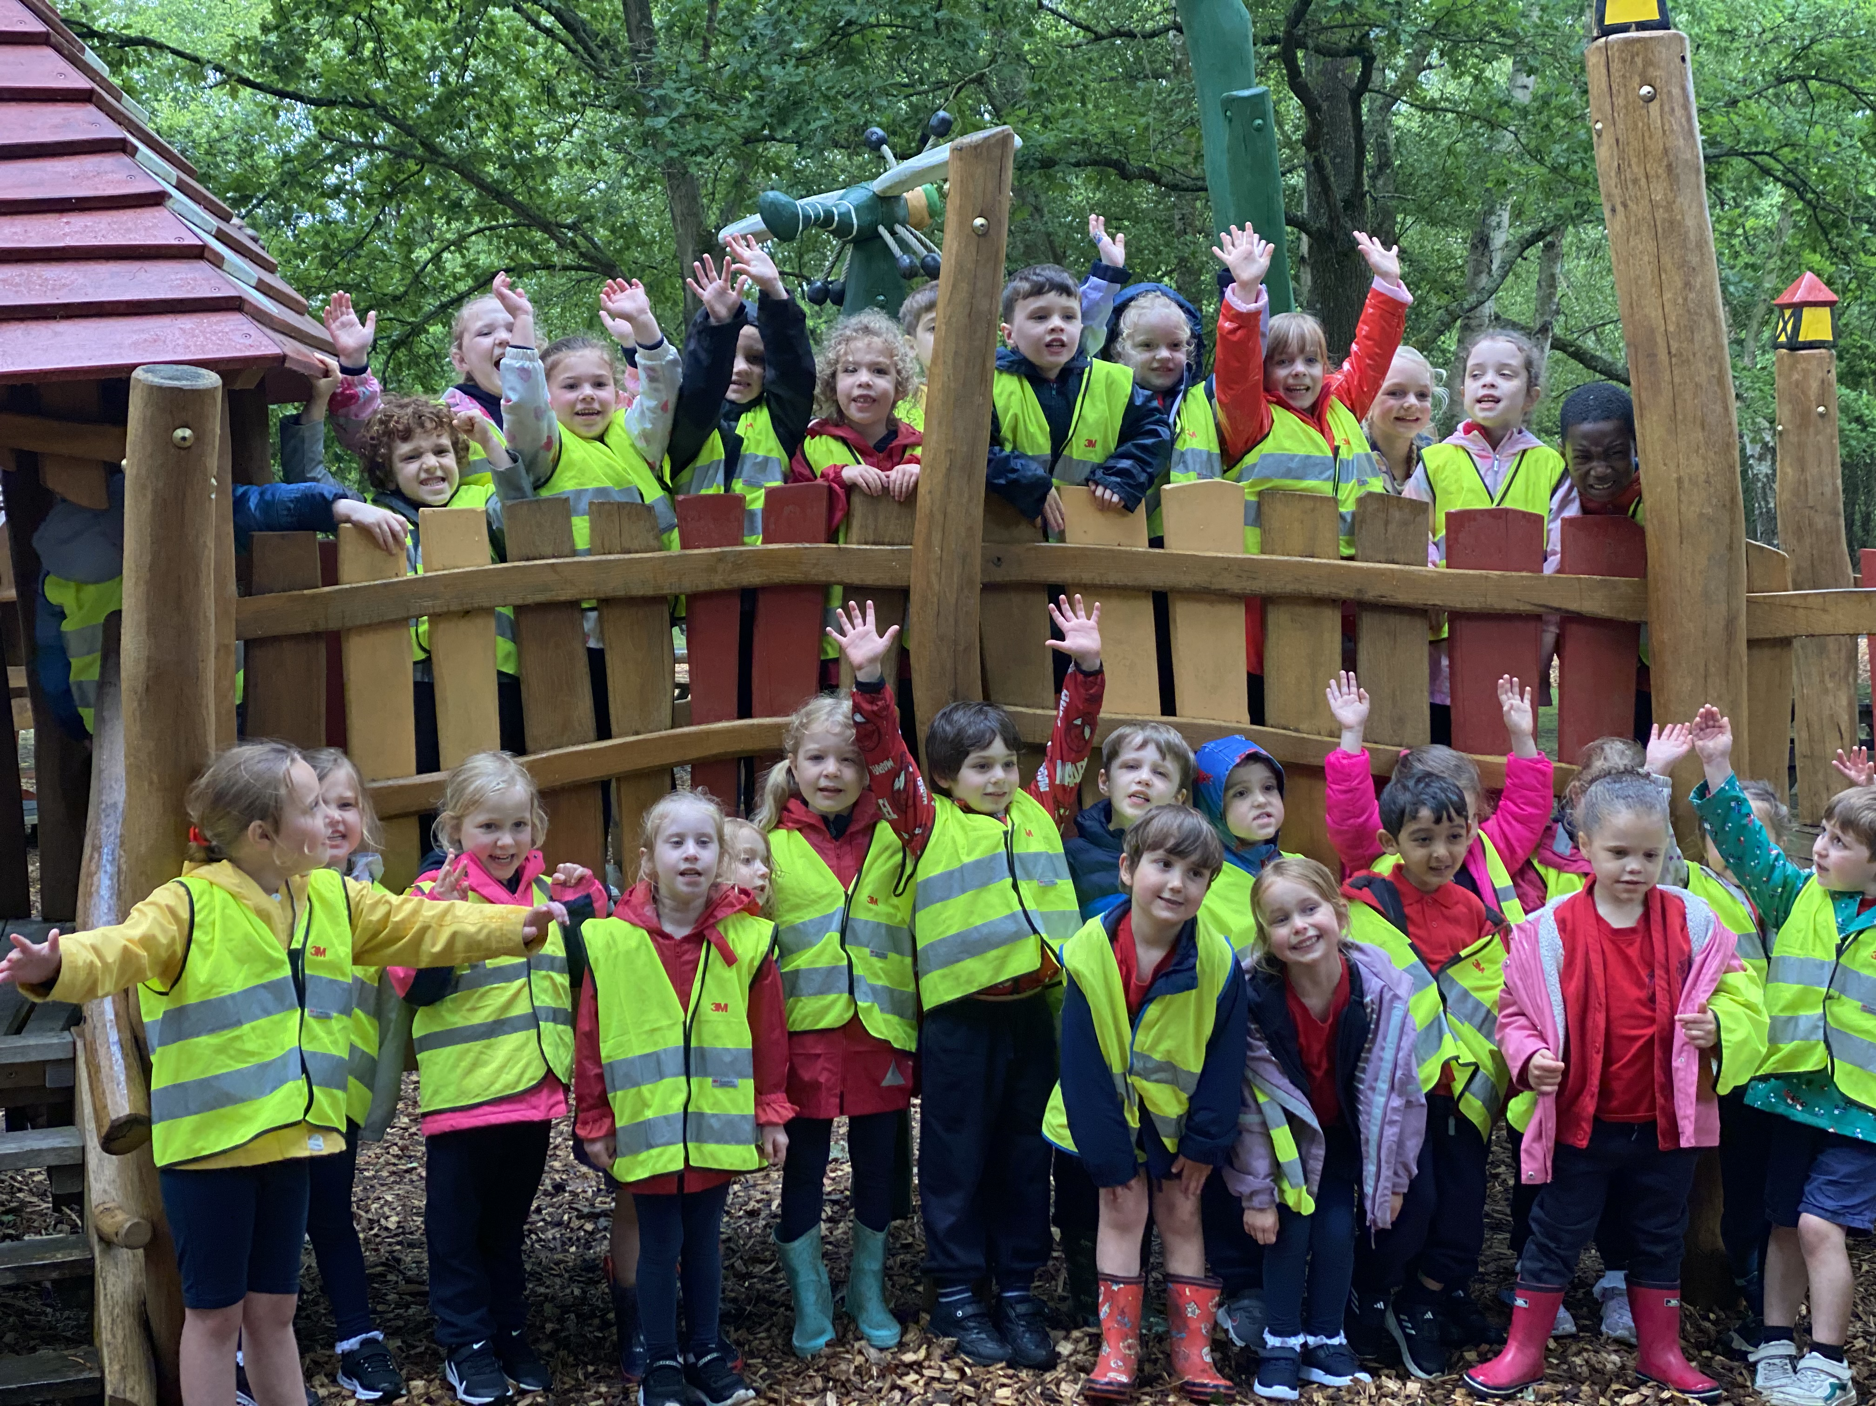
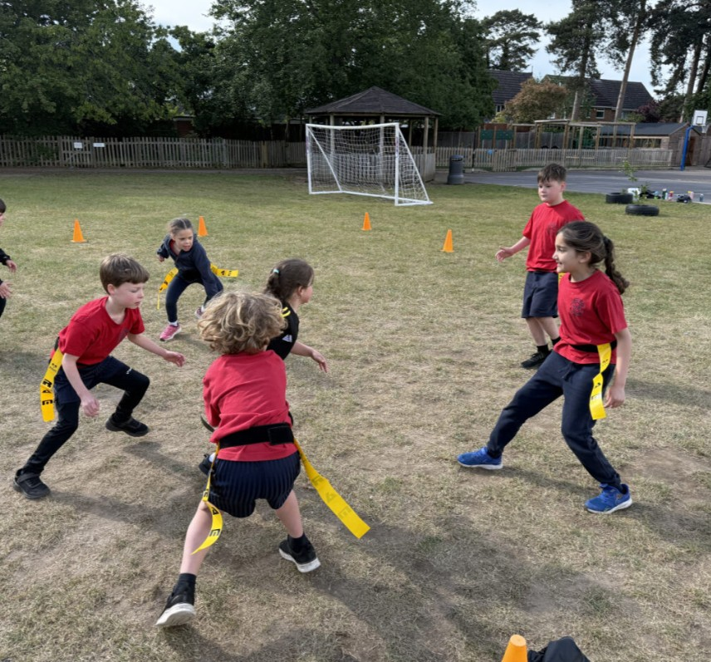
Admin
Trips deadlines
Finances/fundraising
£1,091 – 26 children!
Sports events
Lunchtimes

Slide 15


School Development
Reading – KS2
The aims of Forest School at Hatch Ride are to:
Promote emotional well-being, resilience and self-esteem
Develop social, communication and teamwork skills
Encourage curiosity, independence and problem solving
Foster lifelong connection with the natural environment
Support physical development and managed risk-taking

